Slide 1
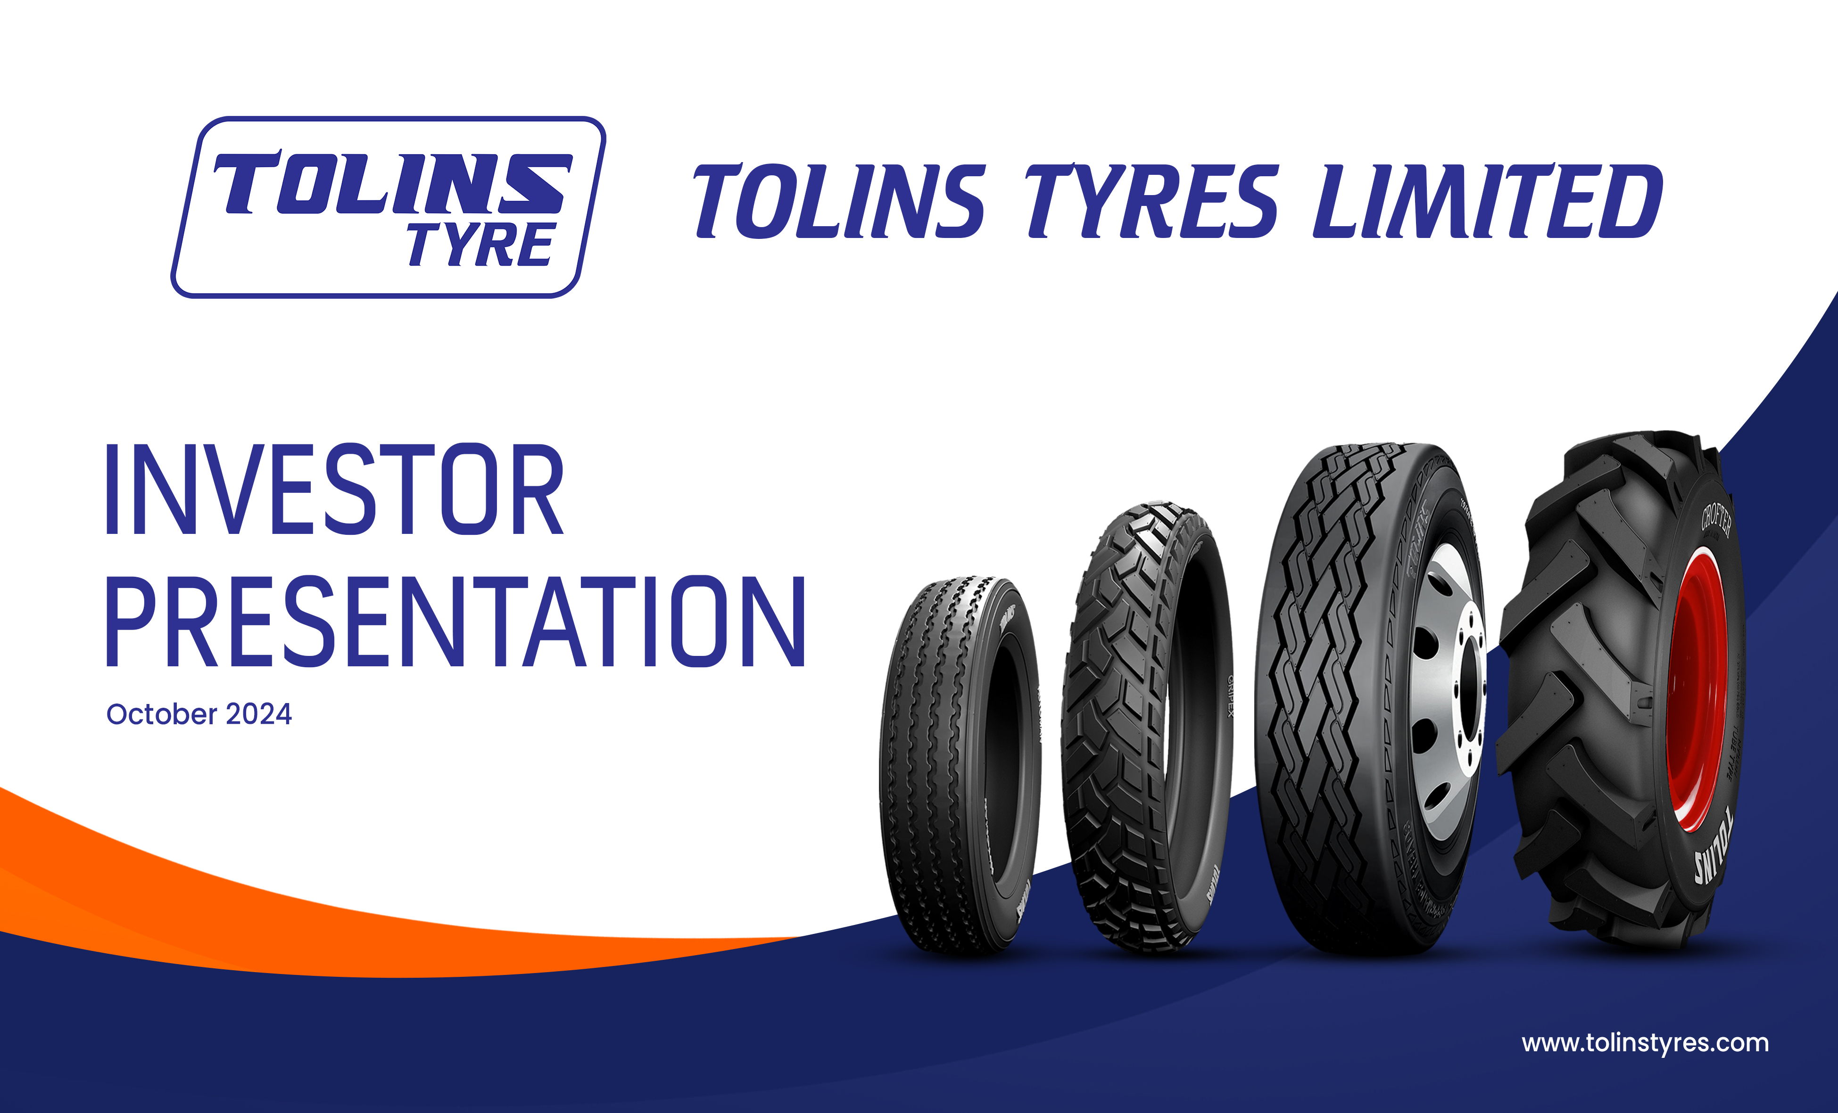
RESULT UPDATE PRESENTATION
Q3 FY25 PERFORMANCE
February 2025

Slide 2

Disclaimer
This presentation has been prepared by Tolins Tyres Limited, solely to provide information about the Company to its stakeholders. No representation or warranty, express or implied is made as to, and no reliance should be placed on, the fairness, accuracy, completeness or correctness of such information or opinions contained herein. None of the Company nor any of its respective affiliates, advisers or representatives, shall have any liability whatsoever (in negligence or otherwise) for any loss howsoever arising from any use of this presentation or its contents or otherwise arising in connection with this presentation.
The information contained in this presentation is only current as of its date. The Company may alter, modify or otherwise change in any manner the content of this presentation, without obligation to notify any person of such revision or changes. Certain statements made in this presentation may not be based on historical information or facts and may be "forward-looking statements", including those relating to the Company’s general business plans and strategy, its future financial condition and growth prospects, and future developments in its industry and its competitive and regulatory environment. Actual results may differ materially from these forward-looking statements due to number of factors, including future changes or developments in the Company’s business, its competitive environment, information technology and political, economic, legal and social conditions in India.
Please note that this presentation is based on the publicly available information including but not limited to Company’s website and Annual Reports.
This communication is for general information purposes only, without regard to specific objectives, financial situations and needs of any particular person. Please note that investments in securities are subject to risks including loss of principal amount.
This presentation does not constitute an offer or invitation to purchase or subscribe for any shares in the company and neither any part of it shall form the basis of or be relied upon in connection with any contract or commitment whatsoever.

Slide 3

Index
Quarterly Performance
Company Overview
Business Overview
Consolidated Financials
Industry Overview & Way Forward

Slide 4
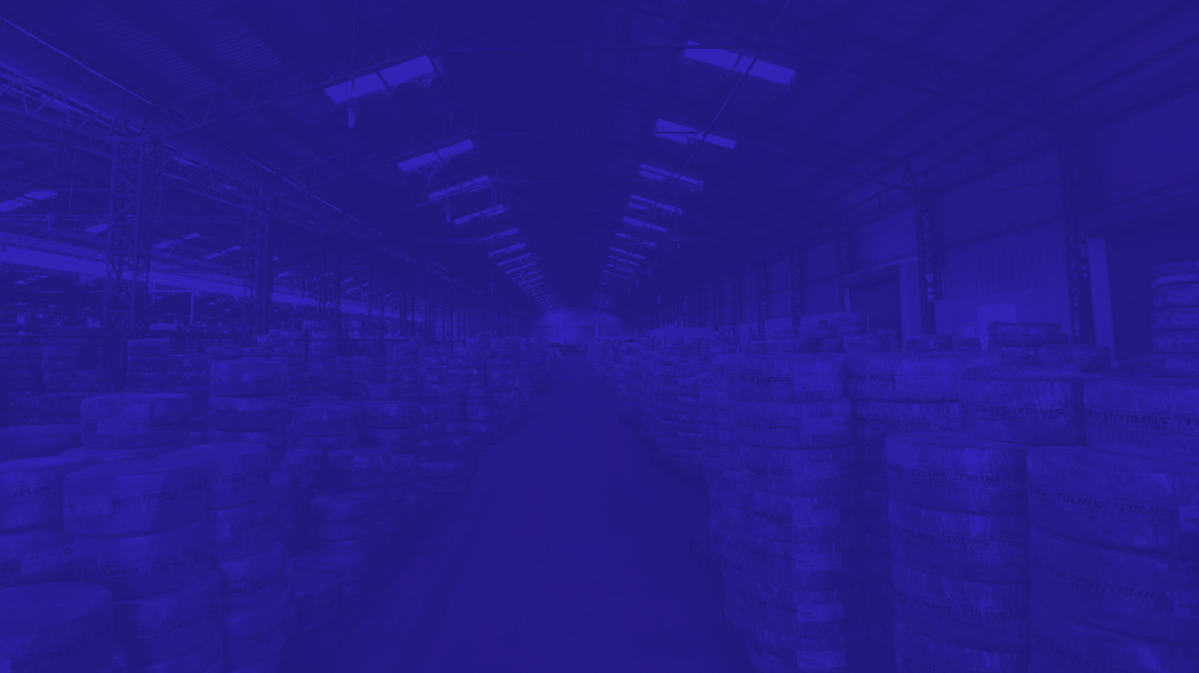
QuarterlyPerformance

Slide 5
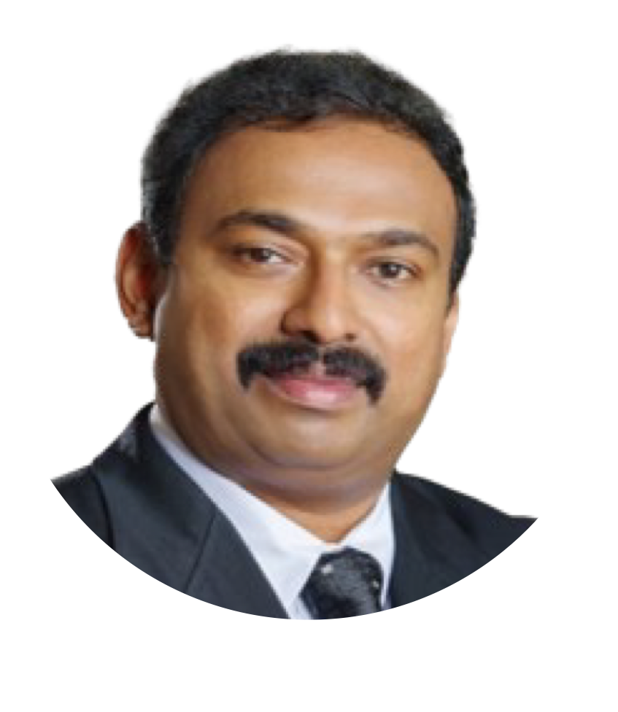
Management Comment
“Despite seasonal demand fluctuations impacting Q3 revenue, we maintained strong profitability, with a record quarterly PAT of ₹10.9 Crore and margins expanding. Our strategic focus on cost optimization, product diversification, and operational efficiency continues to drive sustainable growth. The three-year Offtake Agreement with Apollo Tyres is a significant milestone, expected to enhance capacity utilization and further strengthen our market position. We believe this partnership will also open up new opportunities for collaboration and revenue streams in the long run.
For the nine months ended December 2024, we delivered a solid 55% YoY growth in PAT, supported by business expansion, efficient inventory management, and disciplined cost control. Our EBITDA growth of 31.5% underscores our ability to enhance operational efficiency while scaling our business. Additionally, increased production and sales volumes, particularly through our UAE subsidiary, have contributed to improved capacity utilization. As we move forward, we remain committed to driving innovation, expanding our product portfolio, and strengthening our footprint across key markets to sustain long-term value creation for our stakeholders”
Dr. Kalamparambil Varkey Tolin,
Chairman & Managing Director
Tolins Tyres Limited

Slide 6
Q3 FY25 Financial Highlights
Revenues (Rs. Cr.)
EBITDA & EBITDA Margin %
PAT & PAT Margin %
EPS (Rs.)

Slide 7
Quarterly Income Statement
Particulars (Rs. Cr.) | Q3 FY25 | Q3 FY24 | YoY | Q2 FY25
Revenue from Operations | 69.74 | 75.49 |  | 76.88
Other Income | 0 | 0.00 |  | 0.10
Total Revenue | 69.74 | 75.49 | 1.98% | 76.99
Raw Materials | 51.88 | 57.09 |  | 56.70
Employee Cost | 3.84 | 0.96 |  | 2.06
Other Cost | 1.42 | 1.94 |  | 2.88
Total Expenditure | 57.14 | 59.99 |  | 61.64
EBITDA (excl. Other Income) | 12.60 | 15.50 | -1.63% | 15.25
EBITDA Margin (%) | 18.07% | 20.53% |  | 19.83%
Depreciation | 0.61 | 0.79 |  | 0.77
Interest | 0.6 | 3.15 |  | 2.42
Profit Before Exceptional Items | 0 | 0.00 |  | 12.16
Income From Associates | 0 | 0.00 |  | 0.00
PBT | 12.59 | 12.52 | -2.88% | 12.16
Tax | 1.70 | 1.77 |  | 2.56
PAT | 10.89 | 10.75 | -10.71% | 9.60
PAT Margin (%) | 15.62% | 14.24% |  | 12.49%
Basic EPS | 3.60 | 3.94 |  | 3.20

Slide 8
Nine Months Income Statement
Particulars (Rs. Cr.) | 9M FY25 | 9M FY24 | YoY | FY24
Revenue from Operations | 222.92 | 213.21 |  | 227.22
Other Income | 0.00 | 0.00 |  | 1.48
Total Revenue | 222.92 | 213.21 | 4.56% | 228.69
Raw Materials | 164.40 | 168.97 |  | 164.14
Employee Cost | 8.74 | 3.74 |  | 6.89
Other Cost | 7.15 | 8.09 |  | 9.81
Total Expenditure | 180.28 | 126.22 |  | 180.84
EBITDA (excl. Other Income) | 42.64 | 32.41 | 31.55% | 46.38
EBITDA Margin (%) | 19.13% | 15.20% |  | 20.41%
Depreciation | 2.21 | 1.55 |  | 3.37
Interest | 5.43 | 1.22 |  | 11.58
Profit Before Exceptional Items | 0.00 | 0.00 |  | 32.9
Income From Associates | 0.00 | 0.00 |  | 0.00
PBT | 36.34 | 23.24 | 56.38% | 32.90
Tax | 6.94 | 4.23 |  | 6.892
PAT | 29.40 | 19.01 | 54.65% | 26.01
PAT Margin (%) | 13.19% | 8.92% |  | 11.45%
Basic EPS | 9.72 | 6.96 |  | 9.52

Slide 9
Consolidated Balance Statement
Particulars (Rs. Cr.) | As on Sept 30, 2024 | As on March 31, 2024
Shareholders Funds(a) | 298.20 | 100.53
Equity Share Capital | 19.75 | 15.33
Instrument Entirely in the Nature of Equity | - | -
Other Equity | 278.44 | 85.2
Non Controlling Interest | - | -
Non Current Liabilities(b) | 5.12 | 9.55
Financial Liabilities
Borrowings | 4.65 | 8.8
Provisions | 0.24 | 0.45
Deferred Tax Liabilities (net) | 0.24 | 0.28
Other Non-Current Liablities | 0.00 | 0.02
Current Liabilities(c) | 31.86 | 111.51
Financial Liabilities
Borrowings | 7.27 | 69.97
Trade Payables
Payable to MSME Creditors | 0.55 | 0.97
Payable to Other Creditors | 16.08 | 31.52
Other Financial Liabilities | 0.49 | 1.75
Other Current Liabilities | 2.90 | 1.06
Provisions | 0.25 | 0.04
Current Tax Liabilities | 4.33 | 6.21
Total Equity & Liabilities(a+b+c) | 335.18 | 221.6
Particulars (Rs. Cr.) | As on Sept 30, 2024 | As on March 31, 2024
Non Current Assets (a) | 65.11 | 61.96
Property Plant & Equipment | 29.05 | 29.49
Capital WIP | 10.26 | 10.18
Right of Use Assets | - | -
Goodwill | 20.81 | 20.81
Other Intangible Assets | 0.08 | 0.07
Financial Asssets
Investments | - | -
Other Financial Assets | 1.51 | 1.4
Defered Tax Assets (Net) | - | -
Other Non Currrent Assets | 3.40 | 0.01
Current Assets (b) | 270.07 | 159.64
Inventories | 75.58 | 83.84
Financial assets
Trade receivables | 92.84 | 64
Cash & Cash equivalents | 88.73 | 0.88
Bank Balances other than Cash & Cash Equivalents | 1.72 | 1.79
Other Financial Assets | 0.02 | 1.61
Current Tax Assets | - | -
Other Current Assets | 11.18 | 7.52
Total Assets (a+b) | 335.18 | 221.6

Slide 10
Capacity Build Up
Tolins Tyres Limited (Standalone)
Tolins Tyres LLC (Wholly owned Foreign Subsidiary)

Slide 11
Sales Mix

Slide 12
Sales Mix

Slide 13
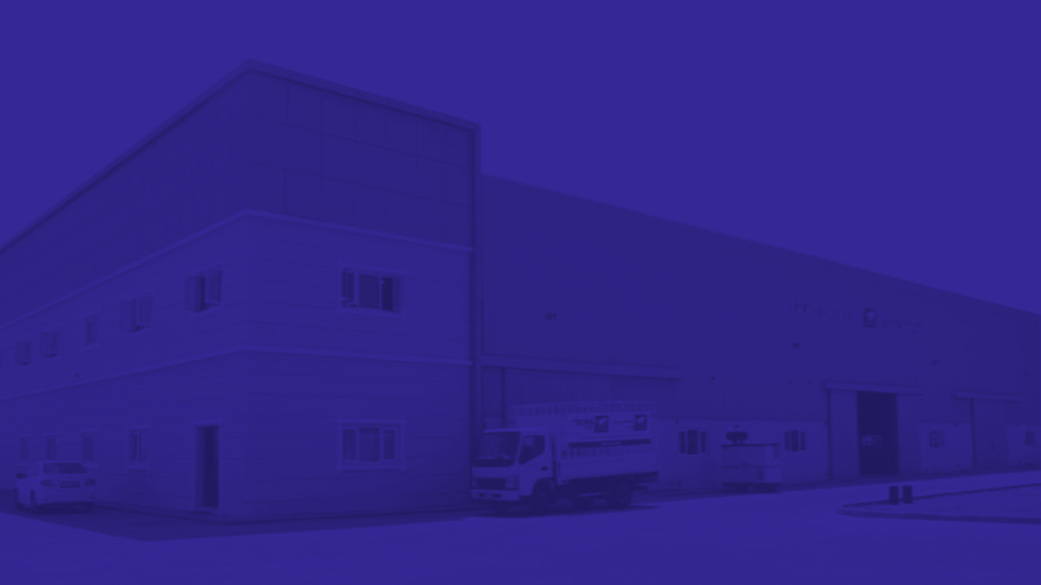
Company
Overview

Slide 14
Facts and Figures
Manufacturing Precured Tread Rubber (PCTR) and Tyres for Light Commercial Vehicles, Agricultural vehicles, and two/three-wheelers under ‘Tolins Tyres’ Brand
Backward integration - manufacturing Bonding Gum, Vulcanizing Solutions, Tyre Flaps and Tubes.
Presence across India with exports to 40 foreign countries including Middle East, the ASEAN region and Africa
3 manufacturing facilities spread across an area of 221,214 square feet – 2 in Kalady, Kerala and 1 in Ras Al Khaimah, UAE
Annual capacity: Tread Rubber - 12,486 tons; Tyres - 1.51 million units and Rubber Compounds - 17,160 tons
Caters to all three segments of market viz. exports, domestic sales and Original Equipment Manufacturers
In FY24, Company merged different business entities involved in Tyre Retreading, Tyre manufacturing and Ancillary Products into one consolidated entity
FY24 Financial Highlights –
  Rs. 227 Cr. Operational Revenue
  Rs. 46 Cr. EBITDA
  25.87% ROE
  36.08% ROCE

Slide 15
Timeline and Key Milestones
1982
2005
2010
2015
2017
2023
Tread Rubber manufacturing Unit was founded by late Mr. K.P. Varkey
Commenced Production and Sale of Precured Tread Rubber (PCTR)
Tolins doubling its tyre production capacity in 2010
Started manufacturing of tyres for two/three wheelers
Secured Bureau of Indian Standards Certification for light commercial vehicle tyres
Acquired two wholly own subsidiaries, namely Tolin Rubbers Private Limited and Tolins Tyres LLC
(One Person)
Incorporated as a private Limited Company
Started manufacturing
of tyres for Light Commercial Vehicle (LCV).
Executed First direct export order
Received certificate from U.S. Department of Transportation for meeting requirements of its federal system standards
Secured Bureau of Indian Standards Certification for two & three wheeler
Acquired plant & machinery in tranches to expand capacity Facility to 5000 tyres per day
Listed on Stock Exchanges
2003
2024
2016
2022
2008
2012

Slide 16
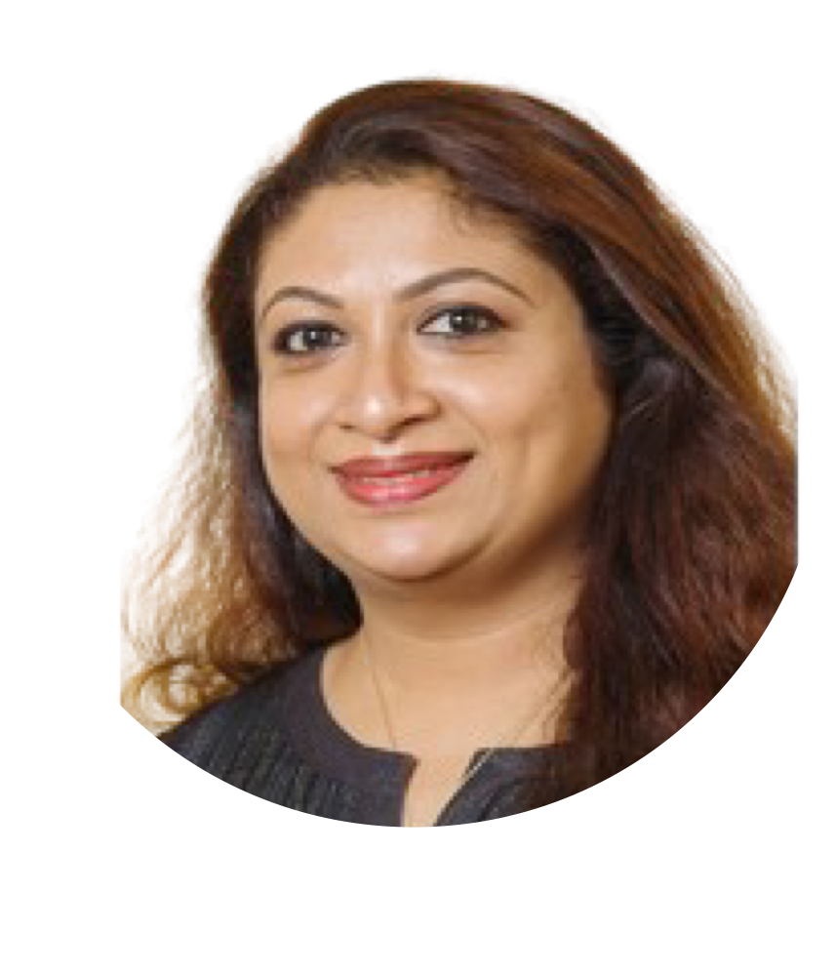
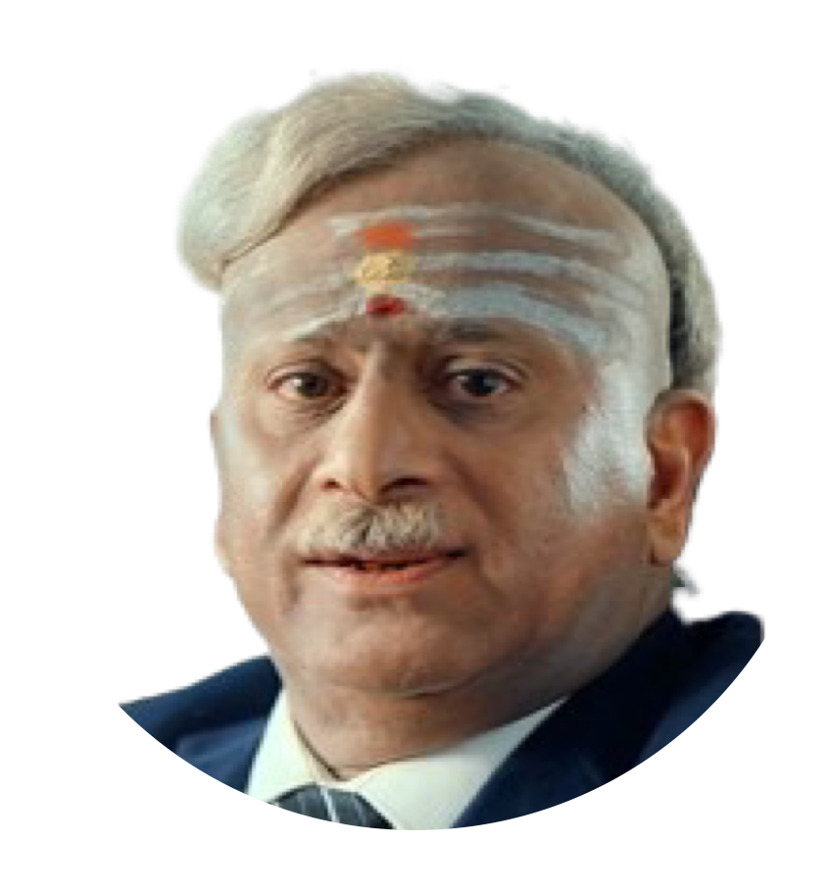
Management - Board of Directors
Dr. Kalamparambil Varkey Tolin,
54, is the Promoter, Chairman, and Managing Director of the company, having been with us since its inception. He holds a B.A. from Mahatma Gandhi University and a Ph.D. in Production Management with a specialization in the tyre industry from Colombo University. With approximately 32 years of experience in the tyre and tread industry, he oversees overall operations and strategic growth initiatives. He is also a recipient of the McMillan Woods Global Award and the Master Class International Export Award.
Jerin Tolin,
aged 46 years, is the Promoter, Non-Executive and Non Independent Director of the Company and has been associated with the company since 2004. She holds B.Sc in Mathematics from Sunrise University, Rajasthan and Bachelor of Education in Mathematics from Vishwa Bharatiya Vidya Parishad. She is an active contributor in the field of education since 2020. She has her proprietorship concern in M/s Rubber Solutions involved in the manufacturing of Vulcanising solutions.
Sankarakrishnan Ramalingam,
63, is the Non-Executive and Non Independent Director of the company and has been with us since 2023. He holds a B.Sc. from the University of Bombay and a Diploma in Industrial Chemistry from British Institutes Bombay. With 40 years of experience in commercial and merchant banking, particularly with Syndicate Bank, he has supported numerous companies as an investment banker in raising funds from equity capital markets. He has also served on the boards of several companies and currently oversees corporate governance, compliance, and overall corporate affairs for the company.

Slide 17
Management - Board of Directors
Dr Joseph P M
Sankar Parameswara Panicker
Cris Anna Sojan
  Joseph P M, aged 50 years, is an Independent Director of our Company.
  He has been associated with our Company since January 17, 2024.
  He is a qualified MBBS from Kempagowda Institute of Medical Sciences, Bangalore and holds a diploma in Orthopaedics from the Rajiv Gandhi University of Health Sciences, Karnataka.
  He has been serving as an orthopaedic consultant in the Ortho Department of P.M.M Hospital, Kerala since 2007.
  Sankar Parameswara Panicker, aged 53 years, is an Independent Director of our Company. He has been associated with our Company since January 17, 2024.
  He holds a Bachelor of Commerce degree from the Mahatma Gandhi University and a bachelor of law degree from Cochin University of Science and Technology, Kochi.
  He is a fellow member of the Institute of Cost Accountants of India and an Insolvency Professional registered with the Insolvency and Bankruptcy Board of India.
  Presently, he is in legal practice and is a partner at Panicker and Panicker, Advocates.
  Previously he was employed at Faramonte Group, HDFC Bank, ICICI Bank.
  Cris Anna Sojan, aged 31 years, is an Independent Director of our Company.
  She has been associated with our Company since January 17, 2024.
  She is an associate member of the Institute of Chartered Accountant of India. Previously, she was associated with EY Global Delivery Services for a period of 5 years.
  Presently, she is self-employed as an independent practicing chartered accountant

Slide 18


Manufacturing Facilities
3
Capability to provide end-to-end manufacturing of rubber and rubber related products, upgrading and modifying assets and equipment.
2 in Kalady, Kerala
1 in Ras Al Khaimah, UAE
spread across 2,21,214 sq. ft. with land area ~ 13.67 acres
Manufacturing Facilities
Kerala Plant 1 - Tyre & PCTR Plant
Kerala Plant 2 - Rubber Compound Plant
Ras Al Khaimah, UAE Plant - PCTR Plant (Owned by Tolins Tyres LLC, wholly owned foreign subsidiary)
Plant Details

Slide 19
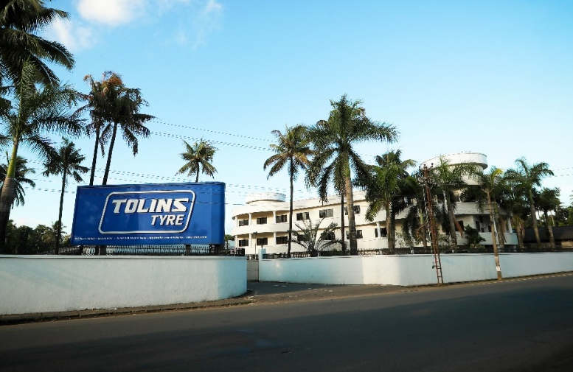
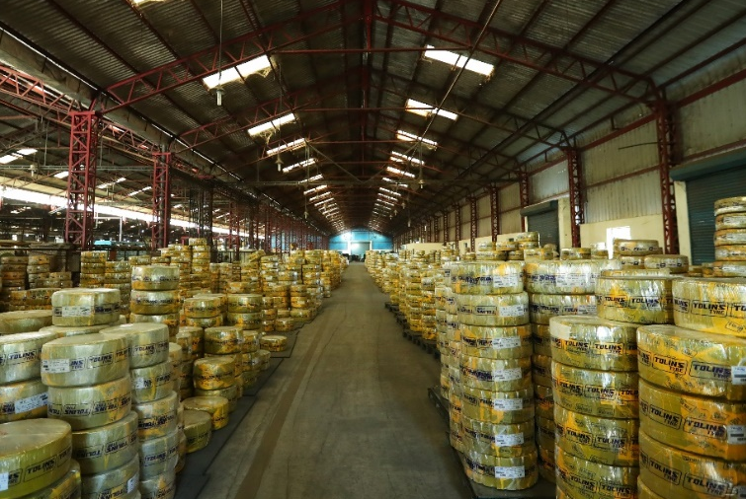
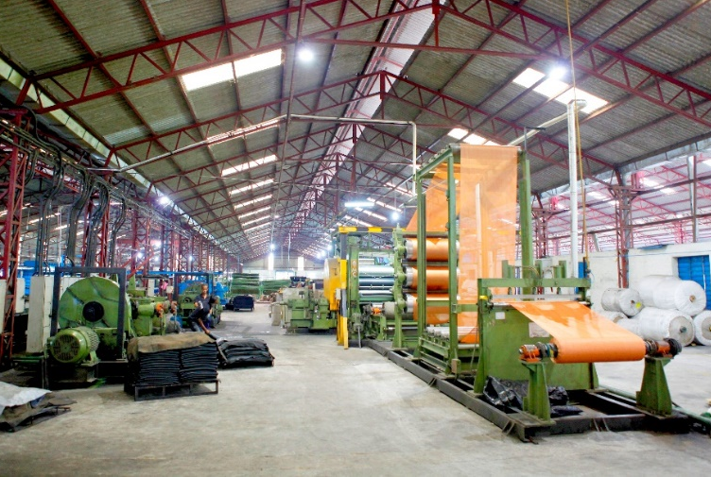
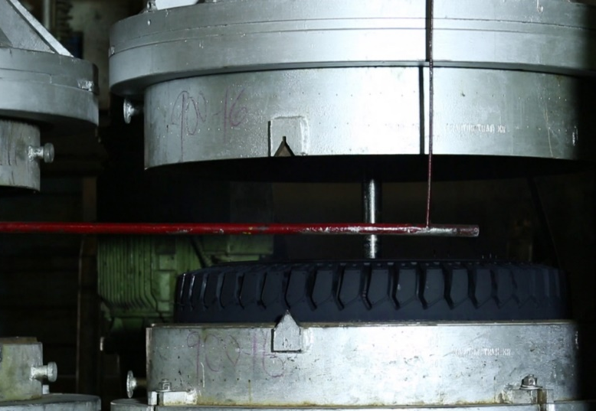
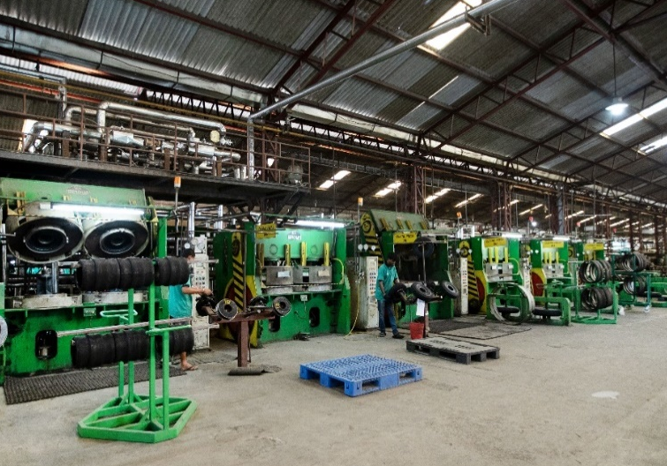
Manufacturing Facilities

Slide 20
Business Overview

Slide 21
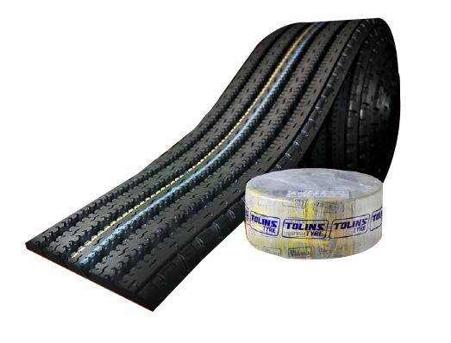
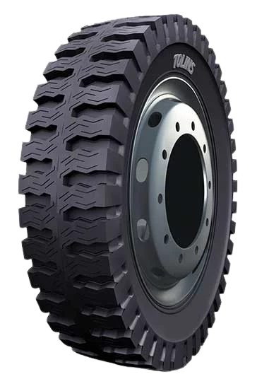

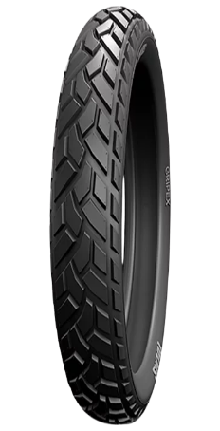
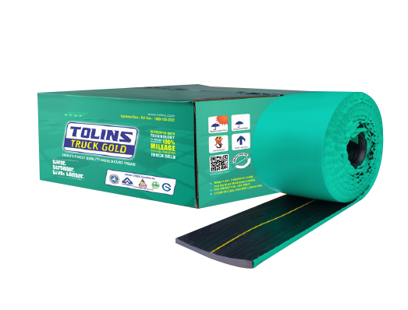
Product Portfolio
Tyre Retreading
Tyres
Precured tread Rubber
(PCTR)
Light
Commercial
Vehicle Tyres
(LCV Tyres)
Off the Road/
Agriculture Tyres
(OTR Tyres)
Two Wheeler & Three Wheeler Tyres
Conventional Tread
Rubber
Note: These images are illustrative in nature

Slide 22

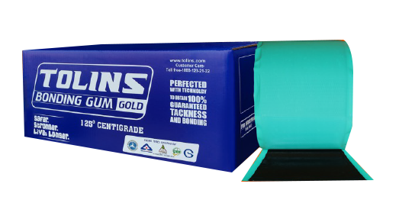
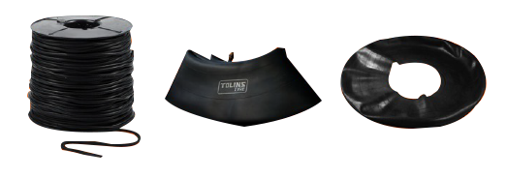
Product Portfolio
Ancillary Products
Bonding Gum
Vulcanizing Solution
Rope Rubber & others
Note: These images are illustrative in nature

Slide 23
Key Strengths
Quality of Products
Quality as key driver of organizational growth. Certifications from U.S. Department of Transportation for exports to USA and E mark E32 for Europe.
Integrated manufacturing operations
coupled with in-house products and
process design capabilities which offer scale, flexibility and comprehensive solutions
Experienced and Dedicated Management Team
Dr. KV Tolin, our Chairman and Managing Director, brings over three decades of techno-commercial management experience in the rubber and tyre industry
Long standing relationship with large OEMs & Dealers
Over three decades of strong relationships with Indian and global customers offering diverse product portfolio
Research and product development capabilities
Prioritise R&D to expand their market share by consistently providing technologically advanced products

Slide 24

Consolidated
Annual Financials

Slide 25
Annual Performance
Revenue (Amount in Rs. Cr.)
EBIDTA & PAT (Amount in Rs. Cr.)
Operational Margins (%)
Financial Margins (%)
Note: Fiscal 2022 and Fiscal 2023 figures are (on a standalone basis) and Fiscal 2024 figures (on a consolidated basis) based on restated financial statement

Slide 26
Annual Income Statement
Particulars (Rs. Cr.) | FY24 | FY23 | YoY
Revenue from Operations | 227.22 | 118.25 | 192.16%
Other Income | 1.48 | 1.43
Total Operational Revenue | 228.69 | 119.68
Cost of Raw Materials | 175.91 | 100.76
Purchase of Stock In Trade | 0.00 | 0.00
Changes in Inventories of Finished Goods, WIP & Stock in Trade | -11.76 | -6.20
Employee Cost | 6.89 | 3.32
Other Cost | 9.81 | 8.10
Total Expenditure | 180.84 | 105.99
EBITDA (excl. Other Income) | 46.37 | 12.26 | 278.25%
EBITDA Margin (%) | 20.41% | 10.37%
Depreciation | 3.37 | 1.61
Interest | 11.58 | 5.05
PBT | 32.90 | 7.03 | 468.17%
Tax | 6.89 | 2.04
PAT | 26.01 | 4.99 | 420.95%
PAT Margin (%) | 11.45% | 4.22%
Note: Fiscal 2022 and Fiscal 2023 figures are (on a standalone basis) and Fiscal 2024 figures (on a consolidated basis) based on restated financial statement

Slide 27
Annual Balance Statement
Particulars (Rs. Cr.) | As on March 31,2024 | As on March 31, 2023
Shareholders Funds(a) | 100.53 | 19.42
Equity Share Capital | 15.33 | 5
Instrument Entirely in the Nature of Equity | - | -
Other Equity | 85.20 | 14.42
Non Controlling Interest | - | -
Non Current Liabilities(b) | 9.55 | 13.21
Financial Liabilities
Borrowings | 8.80 | 13.1
Provisions | 0.45 | 0.1
Deferred Tax Liabilities (net) | 0.28 | -
Other Non-Current Liablities | 0.02 | 0.01
Current Liabilities(c) | 111.51 | 51.19
Financial Liabilities
Borrowings | 69.97 | 33.93
Trade Payables
Payable to MSME Creditors | 0.97 | 0.92
Payable to Other Creditors | 31.52 | 12.31
Other Financial Liabilities | 1.75 | 1.98
Other Current Liabilities | 1.06 | 0.18
Provisions | 0.04 | 0.01
Current Tax Liabilities | 6.21 | 1.86
Total Equity & Liabilities(a+b+c) | 221.6 | 83.82
Particulars (Rs. Cr.) | As on March 31,2024 | As on March 31, 2023
Non Current Assets (a) | 61.96 | 19.77
Property Plant & Equipment | 29.49 | 19.17
Capital WIP | 10.18 | -
Right of Use Assets | - | -
Goodwill | 20.81 | -
Other Intangible Assets | 0.07 | 0.08
Financial Asssets
Investments | - | -
Other Financial Assets | 1.4 | 0.50
Defered Tax Assets (Net) | - | 0.01
Other Non Currrent Assets | 0.01 | 0.01
Current Assets (b) | 159.64 | 64.06
Inventories | 83.84 | 36.96
Financial assets
Trade receivables | 64.00 | 23.83
Cash & Cash equivalents | 0.88 | 0.38
Bank Balances other than Cash & Cash Equivalents | 1.79 | 0.43
Other Financial Assets | 1.61 | 1.09
Current Tax Assets | - | -
Other Current Assets | 7.52 | 1.37
Total Assets (a+b) | 221.6 | 83.82

Slide 28
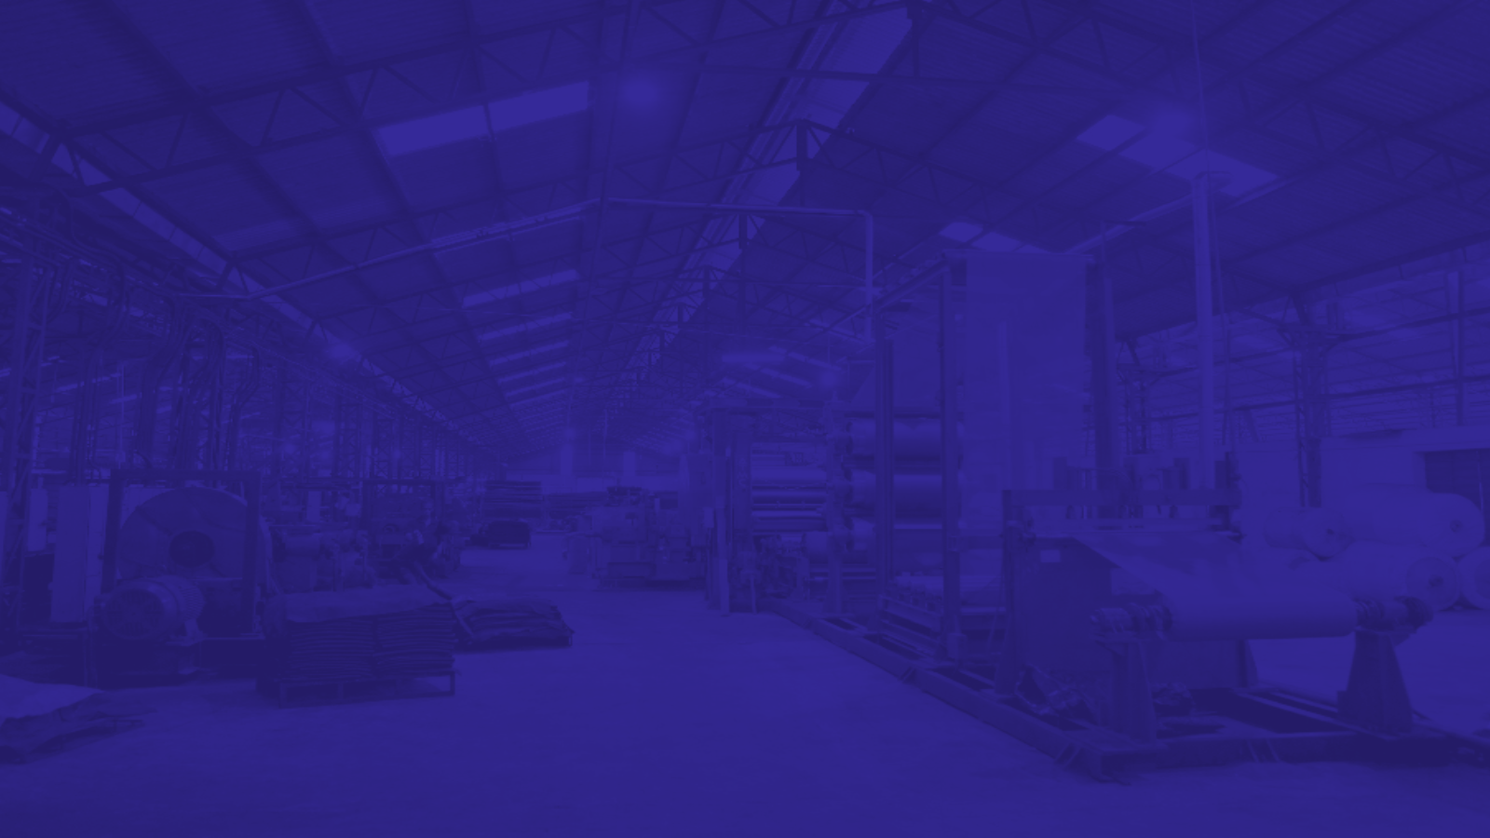
Industry Overview
And Way Forward

Slide 29
Industry Overview
Tyre Industry: Domestic 2-Wheeler Vehicles Outlook
Key Demand Drivers
Macroeconomic support
Rising rural incomes
Rural infrastructure
Financing support
Growing gig economy
Premiumisation in the industry
Electrification in the two-wheeler segment
Shrinking replacement cycles
Advancement in vehicle technology
Million Units
2-4%
CAGR
8-10%
CAGR
5-7%
CAGR
Source: SIAM; CRISIL M&A

Slide 30
Industry Overview
Passenger Vehicles Domestic Demand Outlook
Domestic Industry PV Outlook (Volumes)
Million Units
4.5-6.5%
CAGR
Key growth drivers
Government boost for Compressed natural gas (CNG)
Premiumization trend
New model launches
EV penetration in Passenger Vehicles
GDP per capita
Vehicle Penetration in India
Source: SIAM; CRISIL M&A

Slide 31
Industry Overview
Demand for Commercial Vehicle Outlook
Commercial Vehicles Domestic Sales Outlook
Key growth drivers
Increasing freight rates to aid in materialization of deferred demand.
Shift in fuel types of CVs to CNG
Stable agricultural output
Healthy industrial growth
Focus on infrastructure and higher mining production to bolster tipper demand
Capacity utilization and profitability of transporters
Replacement demand
Scrappage policy
Thousand Units
3-5% CAGR
1150-1270
962
968
Source: SIAM; CRISIL M&A

Slide 32
Industry Overview
Growth for Tractor Outlook
Tractor Industry sales expected to increase 4-6% between fiscals 2024 to 2029
Key growth drivers
Monsoon Performance
Crop Prices
Government Regulations
Financing availability
Non-farm usage of tractors on the rise
Replacement demand expected to
be higher
Thousand units
Source: CRISIL M&A Consulting

Slide 33
Industry Overview
Market Size: Tyre Industry Turnover
Tyre Export Outlook
Estimated Turnover (in Rs. Billion)
Tyre Exports (in Rs. Lakh)
7-9% CAGR
6.9% CAGR
12% CAGR
9.6% CAGR
4.4% CAGR
Source: ATMA, Turnover is based on revenue
Source: ATMA, CRISIL M&A Consulting

Slide 34
Industry Overview
Demand for Passenger Vehicle (PV) Tyre Outlook
Demand for Commercial Vehicle (CV) Tyre Outlook
Outlook for PV tyre demand
CAGR
4-6%
90-110
Outlook for CV tyre demand
CAGR
7-9%
CAGR
6-8%
80-95
CAGR
7-9%
46-58
(Million Units)
(Million Units)
34-35
59
28.8
27.4
Source: CRISIL M&A Consulting
Source: CRISIL M&A Consulting

Slide 35
Way Forward
Optimization of the Capacity Utilization: Aims to progressively increase utilization to 75% over the next few years
Expanding Reach of Domestic and International Markets: Expand presence in the domestic market and focus on key international clusters
Expand Product Range by introducing new product range: Plans to invest in developing new products
Improve Efficiencies with Technology Enablement: Further develop technology systems to increase asset productivity
Pursue Inorganic Growth through Selective Acquisitions: Pursue inorganic growth opportunities through selective strategic acquisitions in the rubber and rubber related products

Slide 36
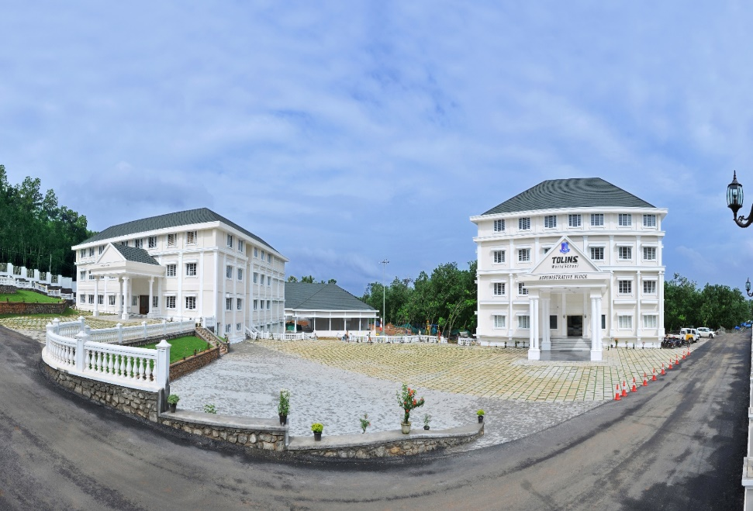
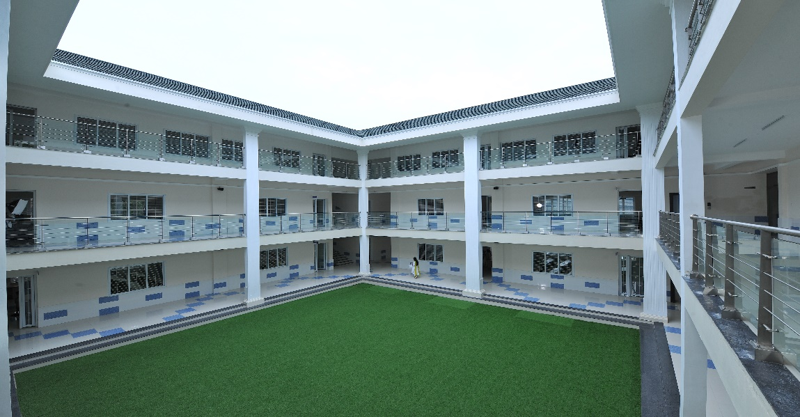
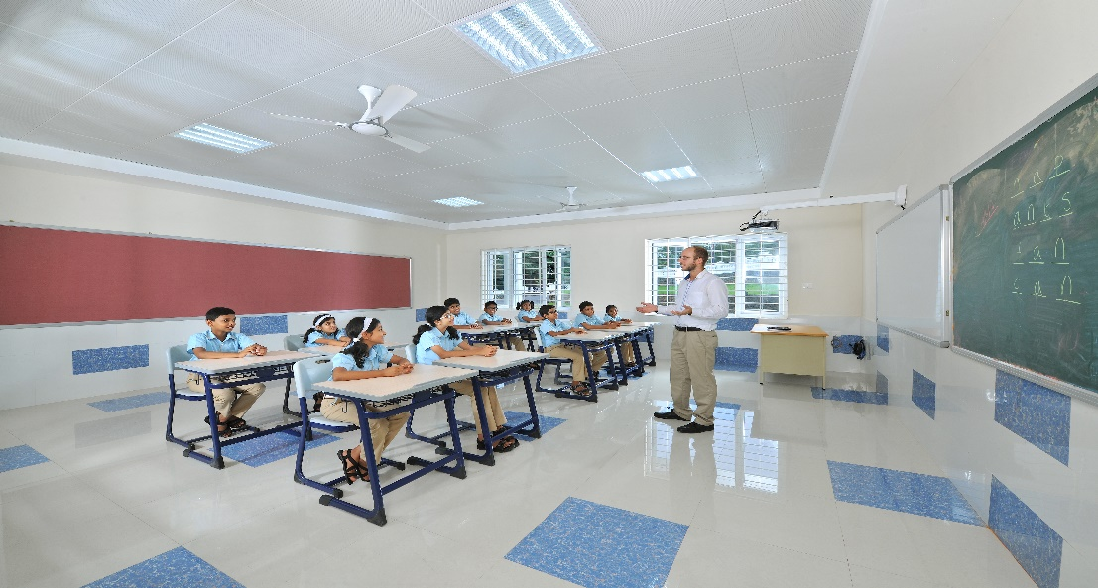
CSR- Tolins World School
In 2014, Tolins Group established an educational institution in Malayattoor, providing education of international standards to kids till Grade 12. By this, the group is committed to give back to its community.
The 15-acre campus of Tolins World School is nestled at the foothills of the Western Ghats and is equipped with all the facilities and amenities essential for providing a top-tier education. This residential co-educational institution can accommodate up to 2,000 students, including a boarding capacity for 1,000
Mission of Tolins World School is to provide every student with a strong foundation for lifelong success, fostering their development into responsible, compassionate, and productive citizens

Slide 37

Thank You
Mr. Ravi Sharma
CFO –Tolins Tyres Ltd.
cfo@tolins.com
Mr. Namit Shah/
Ms. Saloni Nagvekar
AdfactorsPR Investor Relations
namit.shah@adfactorpr.com
Saloni.nagvekar@adfactorspr.com

